Slide 1
Bonnyrigg Primary School
Welcome to Primary 1

Slide 2
Things we will cover
Welcome pack
First day at school
Settling in
Lunch
Curriculum
Health and safety
Classes
Contact with school
Helpers
What will we need?
Questions

Slide 3
Questions?

Slide 4
Further Information
Parksmart
Before and After School Childcare
Lunches

Slide 5
Staff
Mrs Allison Head Teacher
Mrs Findlay Depute Head Teacher
Miss Stark Depute Head Teacher
Class Teachers
P1C Miss Brady
P1B Mrs Douglas (Wed/Thurs and alternate Fri)
Mrs Pettigrew (Mon/Tues and alternate Fri)
P1A Miss Ferguson
Learning Assistants

Slide 6
Class Formation
P1 maximum: 25
P2, P3 maximum: 30
P4-7 maximum: 33
Composite class maximum: 25

Slide 7
This year
P1A
P1B
P1C
These classes WILL change next session.

Slide 8
First day at school
Monday, 20th August 2017
Welcome 9am/1.10pm – Line up
Come in, hang up coats and bags
Settle with teacher
Parents leave
Tea and Tissues/ Coffee and Celebrations
Collect at 11am/3.10pm- children will be dismissed from the classroom door

Slide 9
Settling in 21st- 24th August
8.50am start
10.30 – 10.45am play time
12.00 noon - home time
12.25am Friday- home time
Your child will probably be very tired this first week!
Going home – child and teacher must know who is collecting them

Slide 10
The School Day
First full day – Monday 27th August
8.50am start
10.30 – 10.45am play time
12.00 – 1.00pm lunchtime
3.15pm home time (Monday – Thursday)
12.25pm home time (Friday)

Slide 11
Lunch
Support in the hall
Free school lunches
Packed lunches
Trial lunch (Friday 22nd June)

Slide 12
Curriculum for Excellence

Slide 13
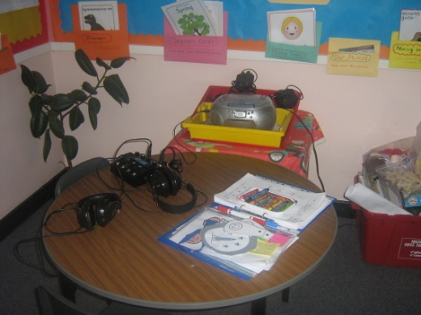
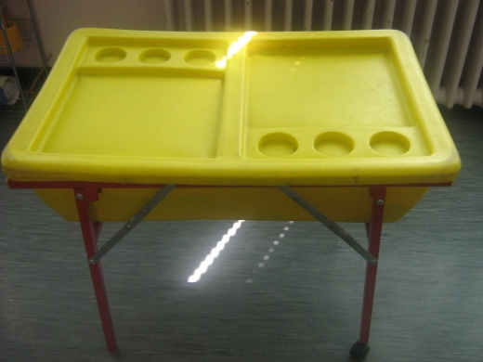
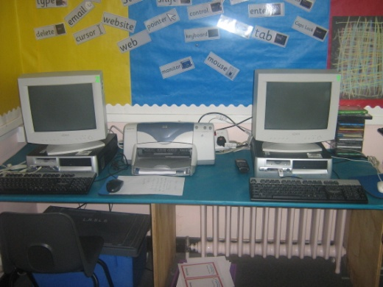
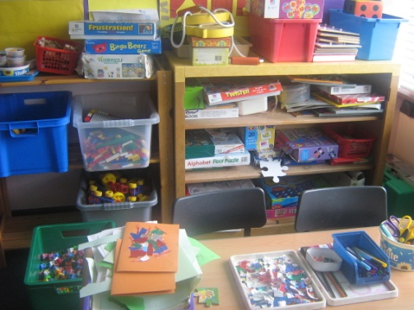
Curriculum
clay
jigsaws
junk modelling
library
sand and water
Active play
supporting and enhancing classroom learning
computer
drawing
dressing up
painting
gluing
Problem solving
Team work
Thinking skills
Imagination

Slide 14
Health and Safety
Start and end of day – handover
Playground safety
Accidents/illness
Allergies/medicines

Slide 15
Contact with School
Absences – 0131 271 4570 (between 8.10am and 8.50am)‏
Money – ParentPay
Homework diaries
Class Assembly
Parent consultations
Termly bulletins
Keep school updated about any changes in information
School must be informed of appointments during the school day and your child must be collected by a named adult
Open door policy

Slide 16
Midlothian Website

Slide 17
School Website

Slide 18
Facebook

Slide 19
Twitter
@bonnyrigg1

Slide 20
What do we need?
Uniform
Bag
Gym shoes
PE kit
Pencil case – pencils, rubber, sharpener, ruler
Healthy snack
Healthy drink (no fizzy juice)
ALL items labelled

Slide 21
Boats Days
Bring
Our
Adults
To
School

Slide 22
Welcome Pack
Welcome to Bonnyrigg School
Reading Information – booklet
Parent Volunteer – booklet
Milk- order form
Park Smart – letter
Bonnyrigg Safe Routes to School

Slide 23
Still to come..............
Play date Monday 11th June 9.45am/1.30pm
Meet your Buddy
Tuesday 12th June 9.45am/1.30pm and Wednesday 20th June 9.45am/1.30pm
Reading Workshop Tuesday 19th June 1.15pm
Step Up Assembly Tuesday 19th June 2.15pm
Coffee and Celebrations/Tea and Tissues Monday 20th August 9.00am/1.10pm
Curriculum Meeting Friday 25th August 9.15am

Slide 24
Parent Council/Fundraising Group

